Slide 1

Vehicle Service Management System
Guided By:
Mrs: Bakul Joshi Mam
Submitted By:
Shreyas Malvadkar (220943020095)
Shismohammad Mulla (220943020055)
Somesh Bhosale (220943020101)
Digvijay Bhakare (220943020011)
1

Slide 2
Aim & Objectives:
The main objective of this project is to build a website that improves user accessibility and time flexibility to help customers and authorized vehicle service centers.
Customers will be able to browse the service center’s information, and view offers provided by the service centers.
Customers can book service slots after login, and could track servicing status.

Slide 3
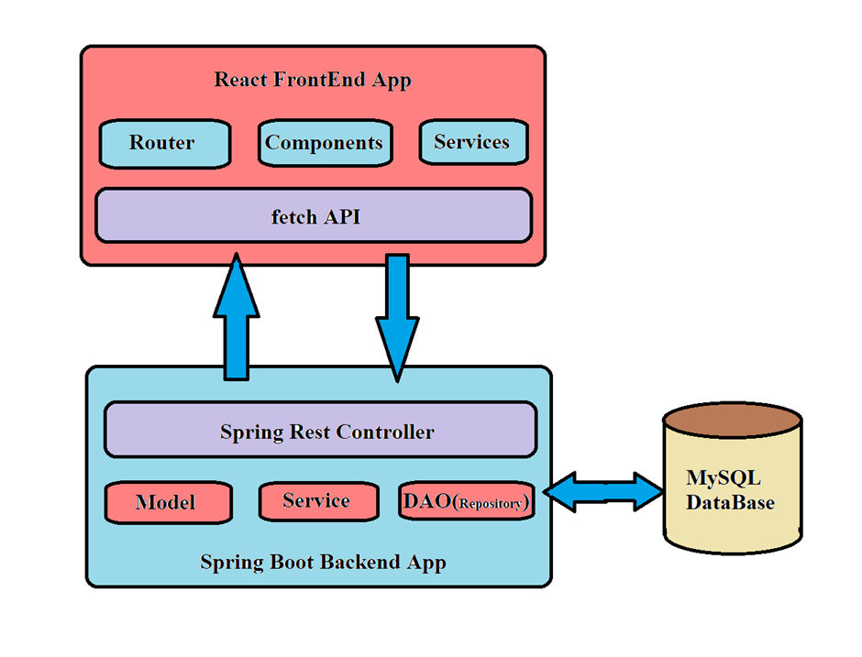
Project Architecture Diagram:

Slide 4
Customer Module
Customers can register.
Customer can login to the system.
Customer can register their vehicle.

Slide 5
Customer Module
Customer can view service packages along with standard rates offered by the service centers.
Customers can check the progress of the service.
Customer can view past service records.
Customer can give rating and feedback.

Slide 6
Service Center Module
Service centers can request for registration.
Service centers can login to the system.
Service Centers can update Service Progress status
Service Center Generates Invoice

Slide 7
Admin Module
Administrator will approve the registration request of service centers.
Create/update the list of standard tasks.
Could generate a report about completed servicing tasks.

Slide 8
Future Scope
Pan India Availability (multiple Cities)
Sending Service Progress Status to Customer by Email and SMS
Allowing Service Centers to Create Suitable Packages

Slide 9
Thank You

